Slide 1

DriverPass System Analysis
Hutch Ellis
Notes:
[No speaker notes required for this slide.]

Slide 2

System Requirements
The DriverPass system has many functional and nonfunctional requirements.
Here are a few examples of each:
Functional Nonfunctional
1.) User-friendly interface that is easy to navigate.
1.)Scalability allows the system to accommodate a growth in users.
2.) Provide users the ability to reset their password.
2.) Security is important for any system that handles sensitive information.
Notes:
As you can see from the functional requirements, DriverPass looks to provide users with a friendly interface as well as the ability to reset their password. If users struggle to reset their password, they may have an IT admin assist them. The system is web based so scalability will allow DriverPass to be ready for a growth in users. Security will help protect users’ personal information and payment information.

Slide 3
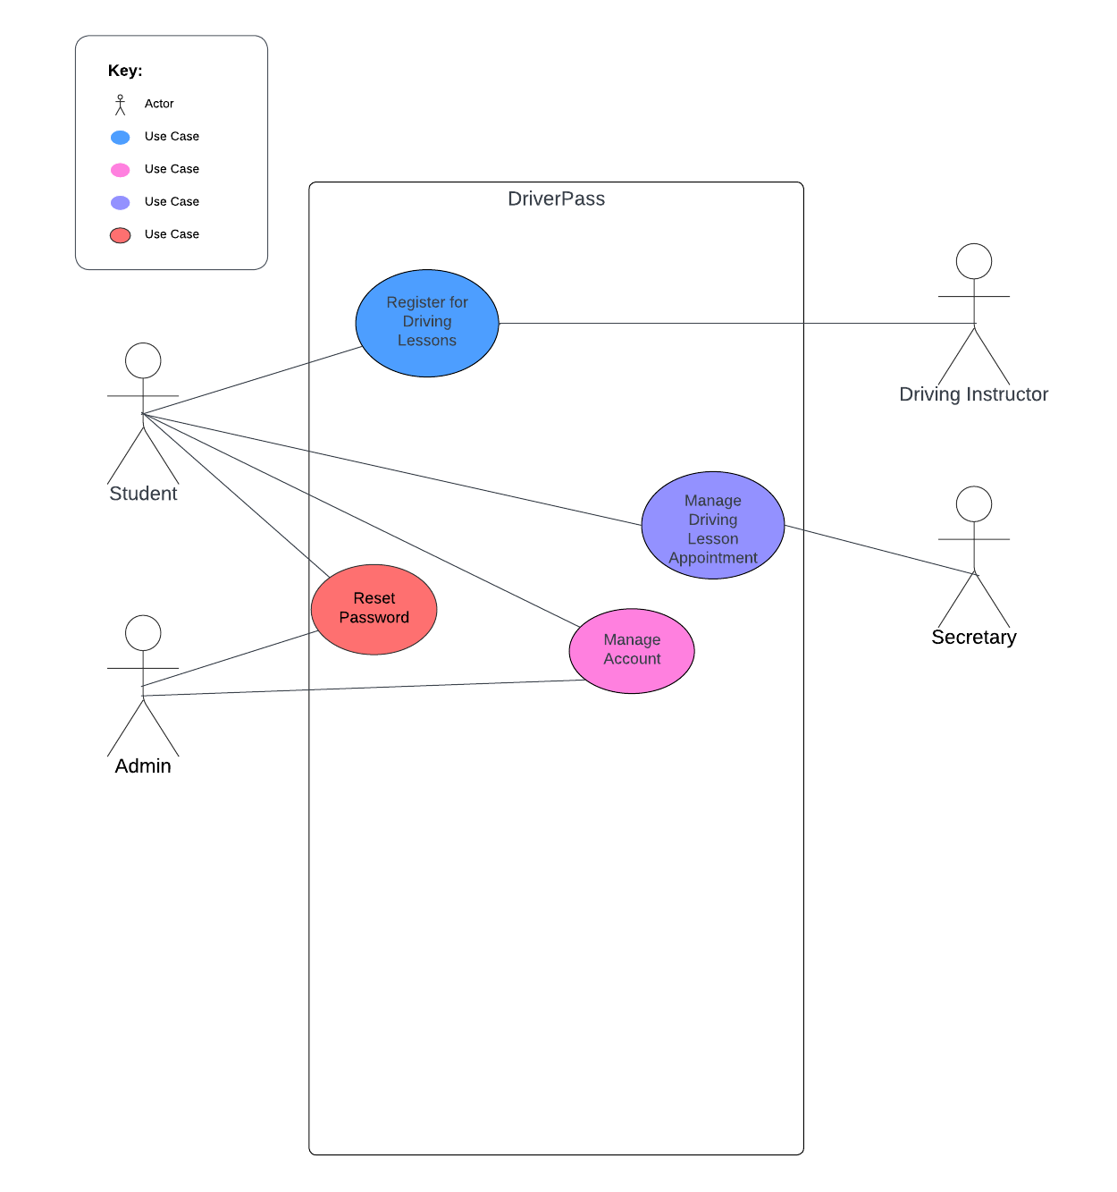
Use Case Diagram
Notes:
This use case diagram illustrates the use cases of the DriverPass system. Students and Instructors are both able to register for lessons, students and secretary are both able to manage driving lesson appointments, student and admin are both able to reset password and manage account.

Slide 4
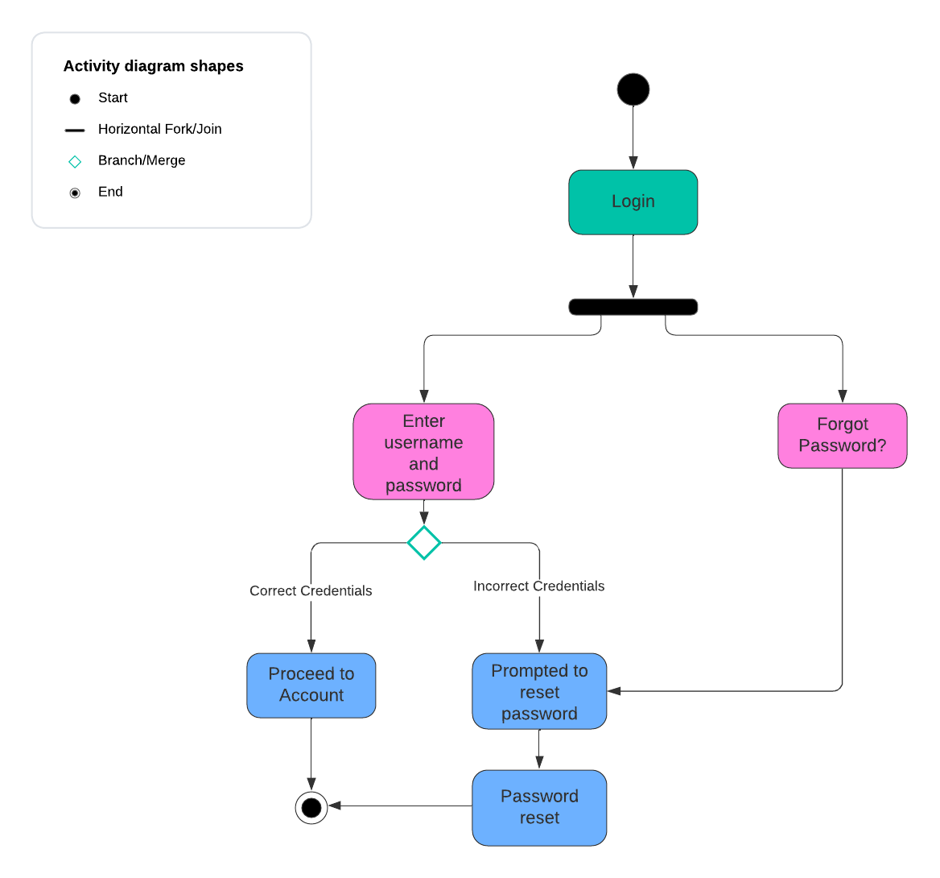
Activity Diagram
Notes:
This activity diagram illustrates the process of resetting a password. First a user would either attempt to login or simply select the forgot password option. If the user attempts to login and enters the incorrect credentials they will be prompted to reset their password. Likewise, if someone clicks the forgot password option they will be prompted to reset their password. If the user enters the correct credentials they may proceed with the login.

Slide 5
Security
Protection against brute force hacking attempts by limiting number of login attempts.
Transport Layer Security (TLS) is used for communication between the client and the server.
Notes:
If a user attempts to log into an account too many times their account may be temporarily locked. This is part of the security against brute force hacking attempts. Using Transport Layer Security provides a layer of security for the connection or data exchange between the client and the server.

Slide 6
System Limitations
Resources
Time
Budget
Technology
Notes:
The DriverPass team is quite small so the limitation with resources comes from the inability they may face when it comes to scalability. Our time limitation is that this project calls for a tight deadline for such a small team to achieve. We are not given an exact amount for the budget but after totaling all the costs of the project, DriverPass may want to cut or modify certain features to make the cost more affordable. Some technology limitations are that not all technology is compatible with one another.

